Slide 1
DBMS MINI PROJECT
DONE BY,
PRAVEEN RAJ S(19S025)
PREM KUMAR jb(19S026)
PREM NITIN p(19S027)
RAHUl n(19S028)
SAI SURAJ m(19S029)
SANTHOSH kumar s(19S030)

Slide 2

Project Title
d

Slide 3
PROJECT DESCRIPTION
A system in which data of Patient, data of donor, data of blood bank would be saved and will be interrelation with each other DATA OF PATIENT – Patient Name, Patient Id, Patient Blood Group, Patent Disease – Donar Name, Donar Id, Donar Bood Group, Donar Medical report, Donar Address, Donar Contact number DATA OF BLOOD BANK – Blood Bank Name, Blood Bank Address, Blood bank Donors name, Blood Bank Contact Number, Blood Bank Address Try to implement such scenario in a database, create a schema for it, an ER diagram for it and try to write SQL Queries

Slide 4
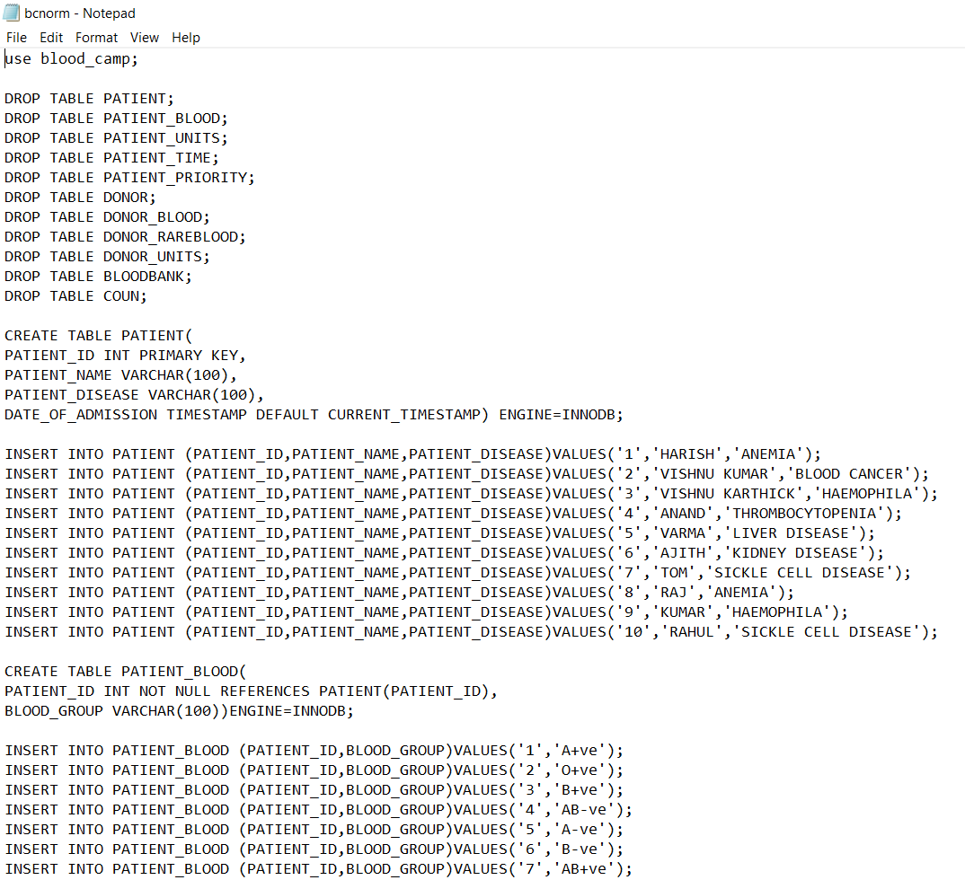
DATABASE BLOOD_CAMP

Slide 5
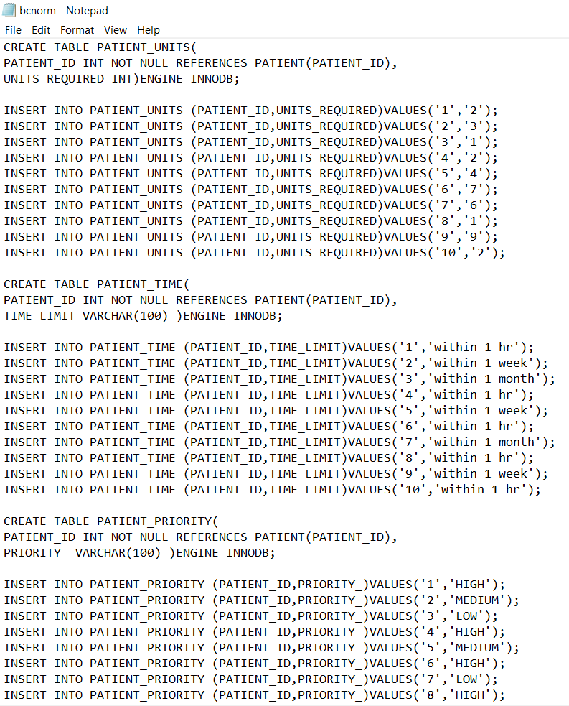

Slide 6
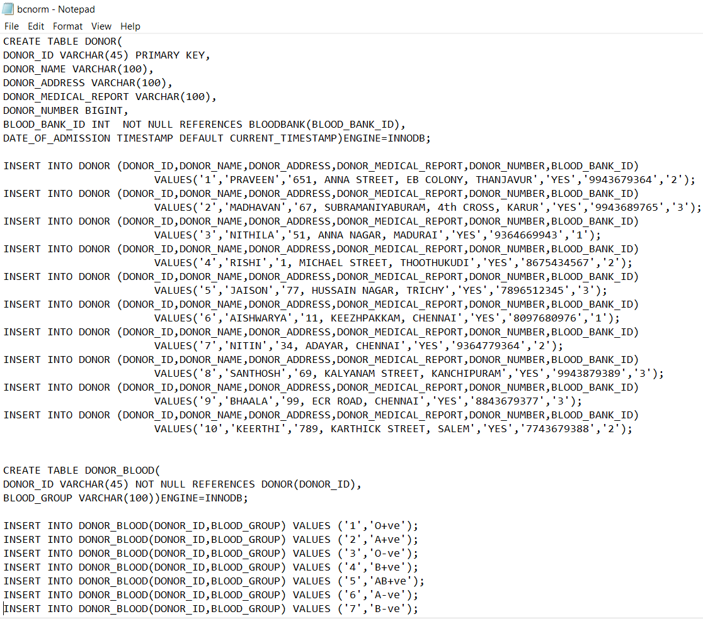

Slide 7
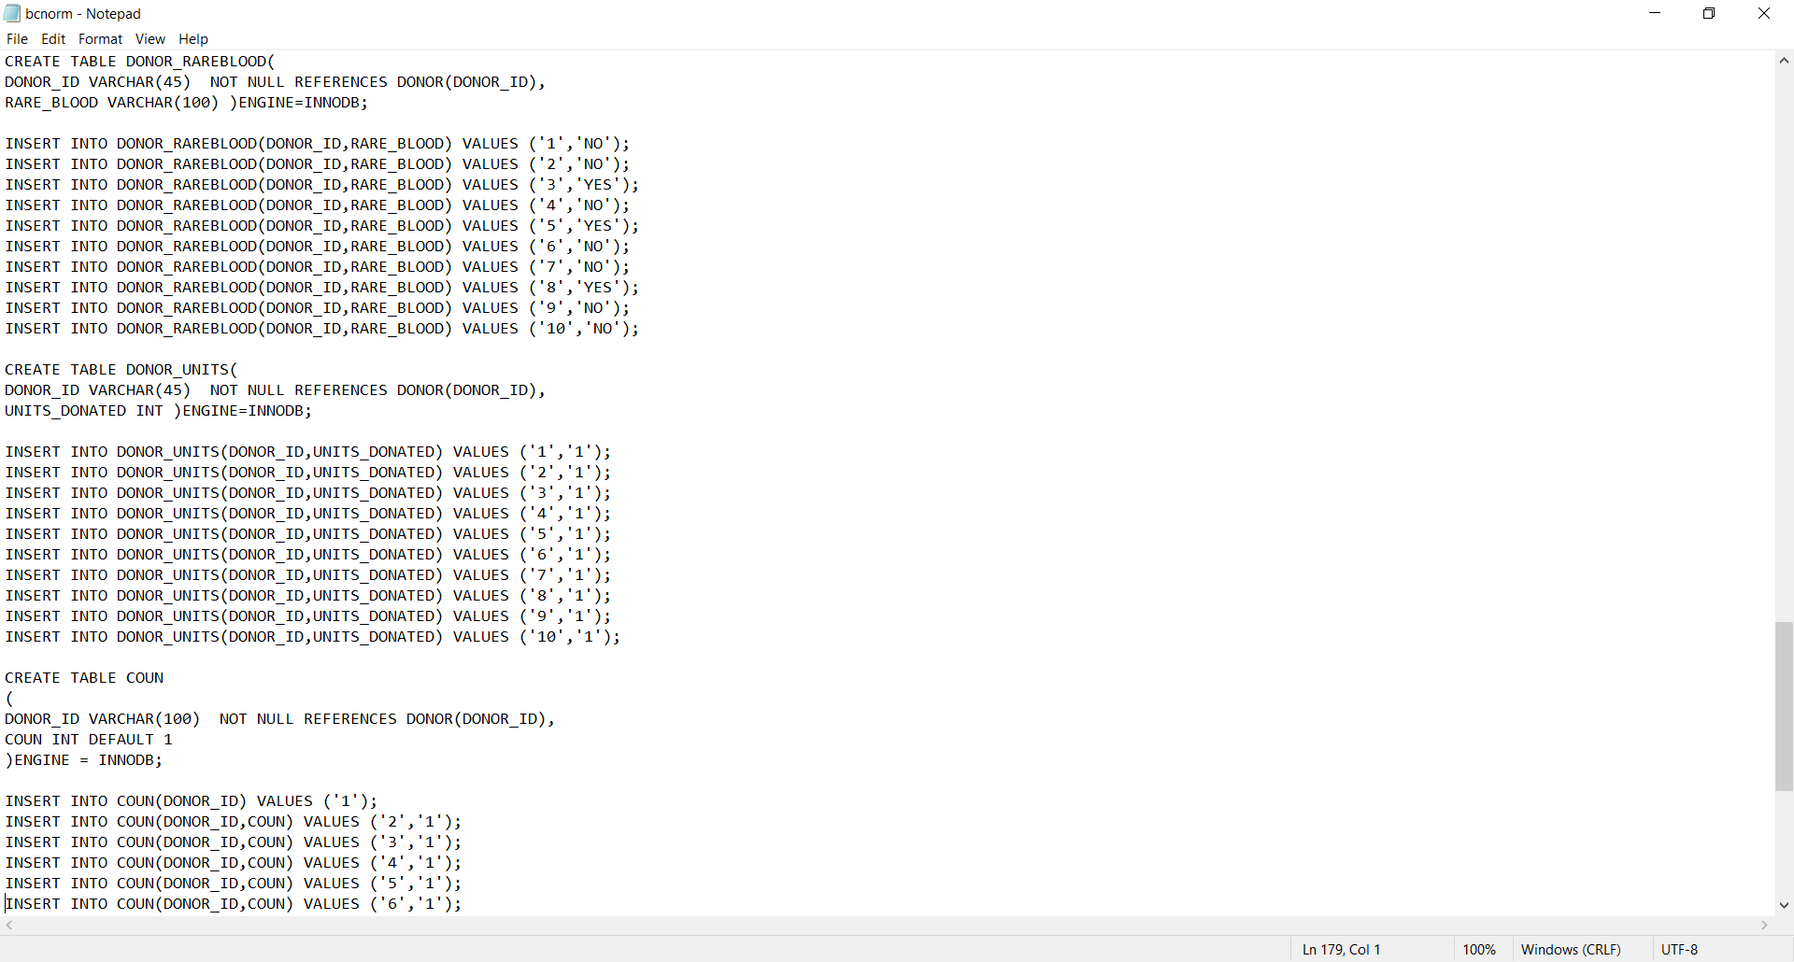

Slide 9
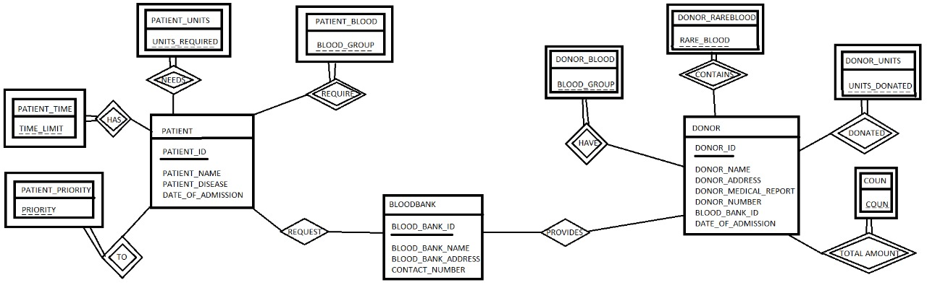
ER DIAGRAM

Slide 10
Line up of activities for the project
Front end: HTML
01
Back end: PHP
02
Connecting php and html
03

Slide 11

HTML IMPLEMENTATION

Slide 12
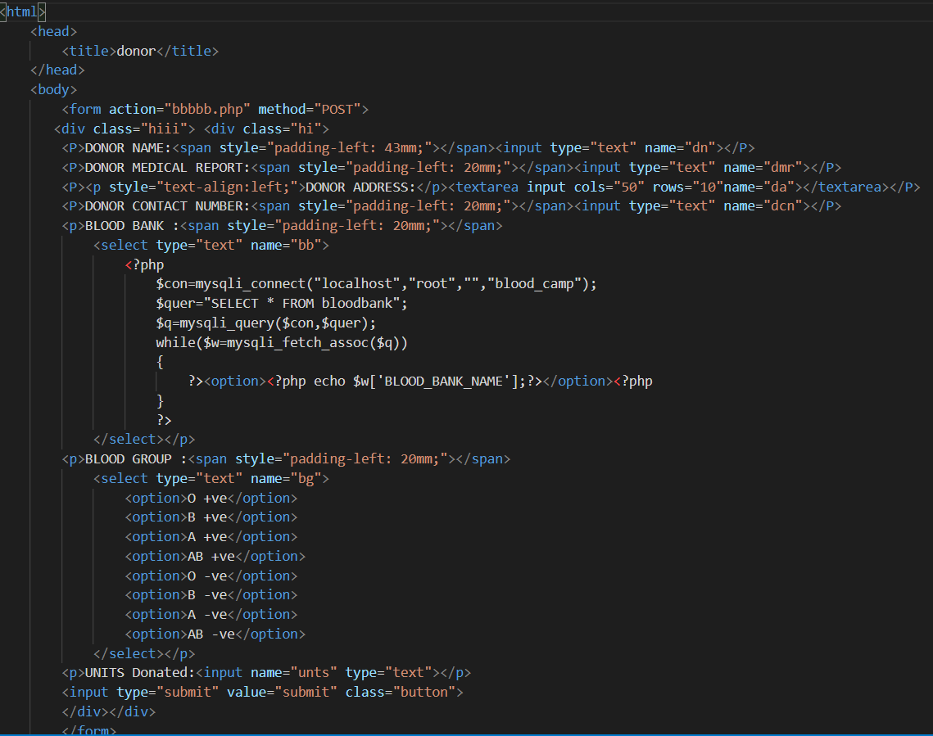
HTML source code for donor and blood bank table inputs

Slide 13
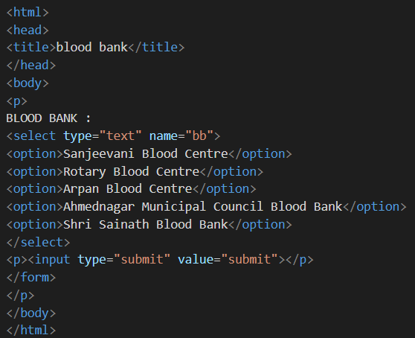

Slide 14
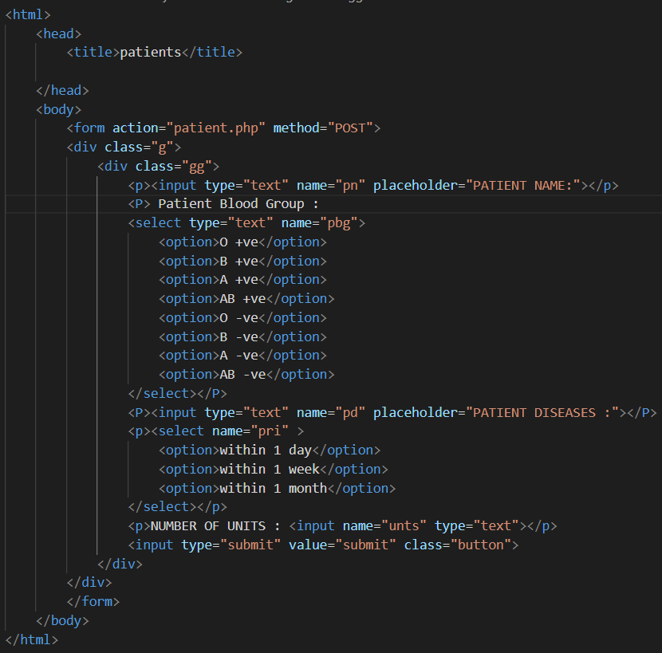
HTML source code for patient table inputs

Slide 15

Php implementation

Slide 16
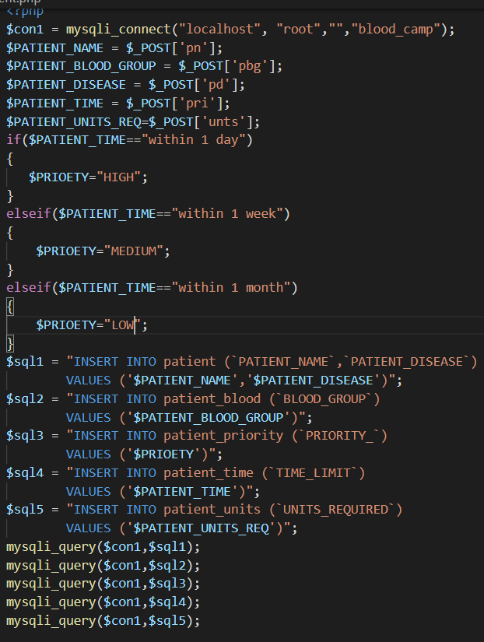
Php source code to insert patient table inputs

Slide 17
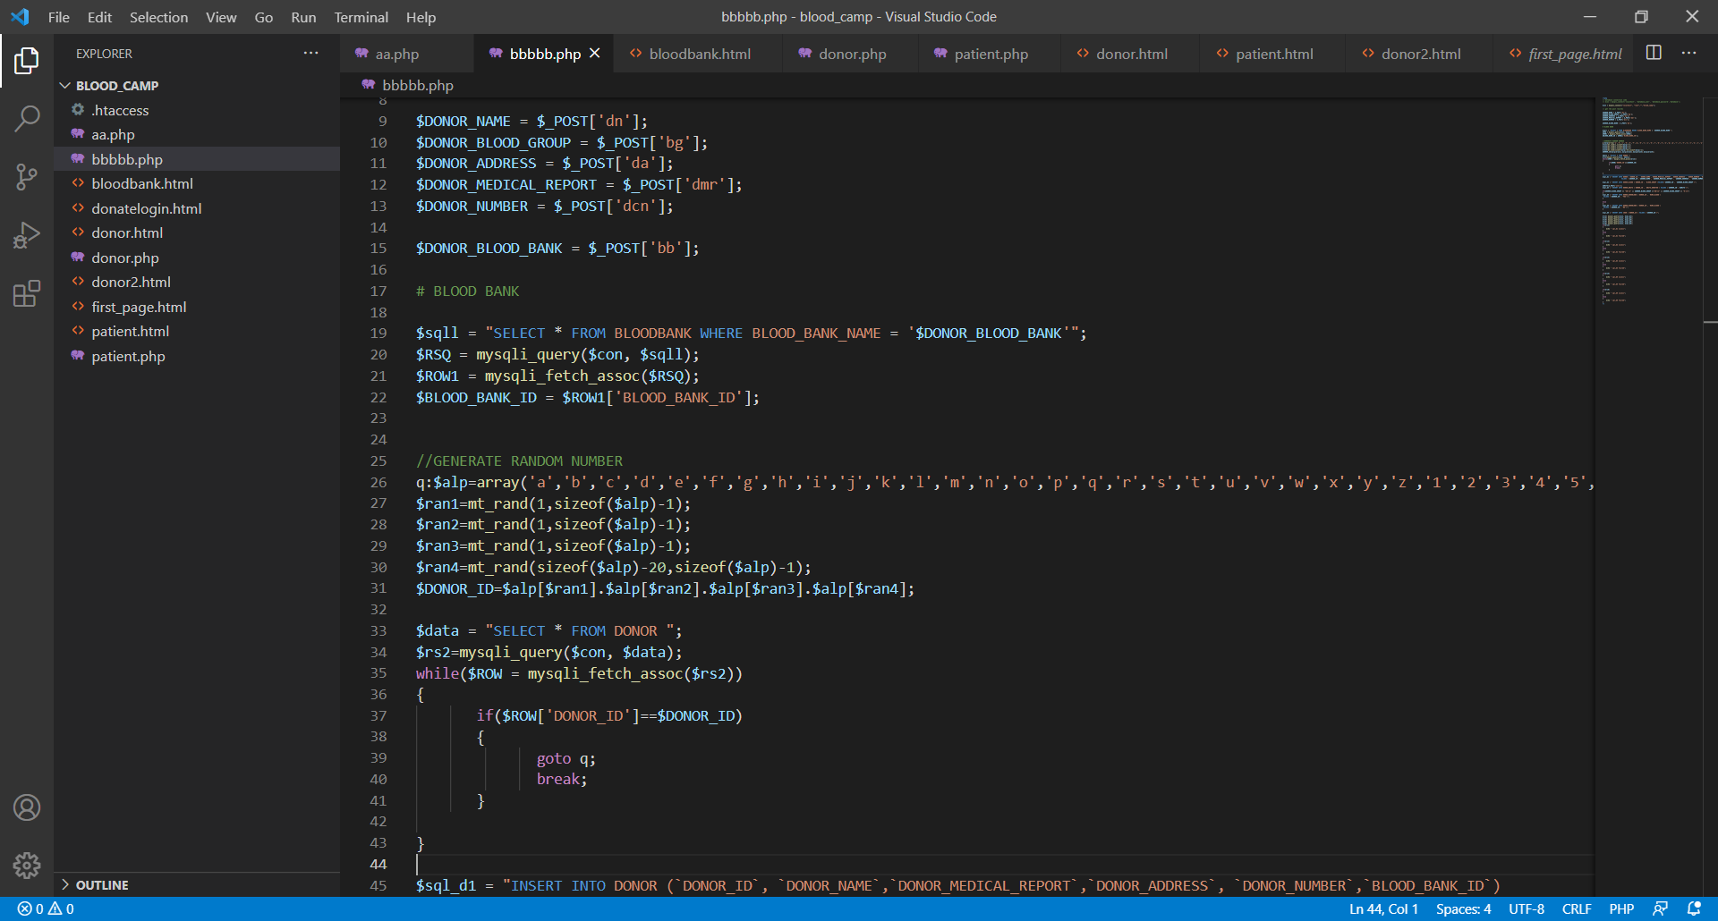
Php source code to insert donor and blood bank table inputs

Slide 18
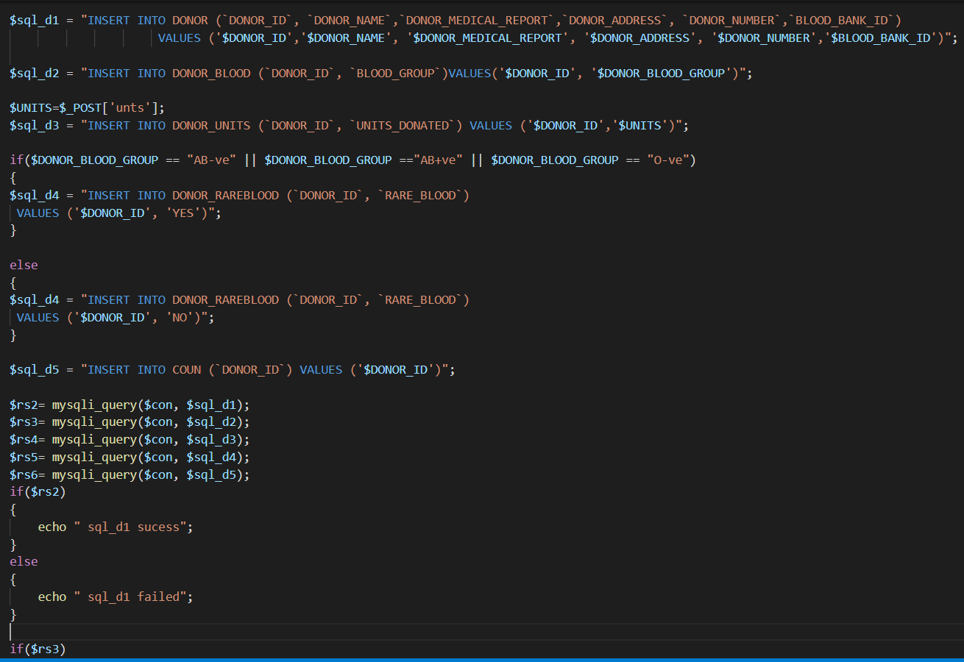

Slide 19
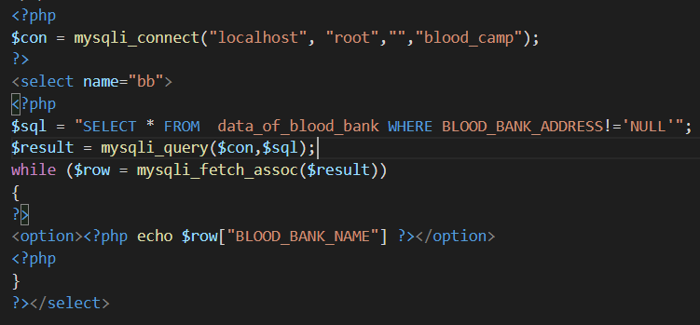

Slide 20
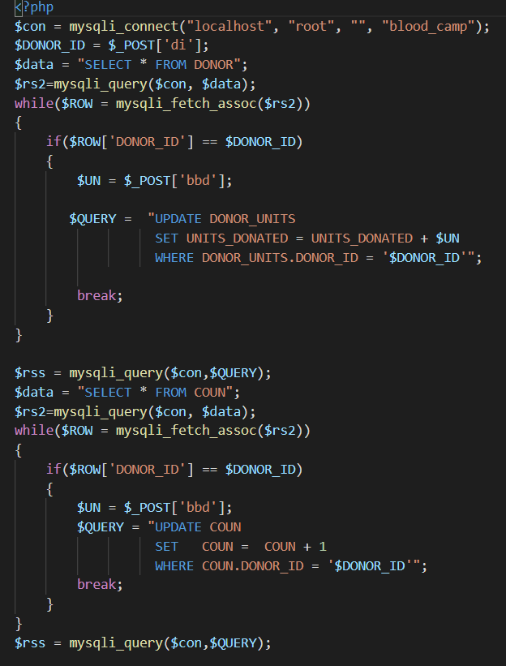

Slide 21


